Slide 1
Day 1: Introduction and Basics of I/O

Slide 2
Data types?

Slide 3
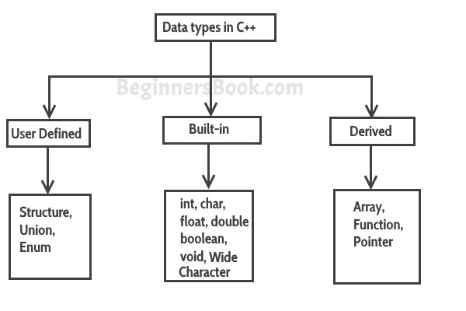
Data types

Slide 4
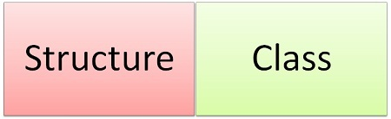
Difference Between Structure and Class

Slide 5
BASIS FOR COMPARISON | STRUCTURE | CLASS
Basic | If access specifier is not declared, by default all member are 'public'. | If access specifier is not declared, by default all members are 'private'.
Declaration | struct structure_name{ type struct_element 1; type struct_element 2; type struct_element 3; . }; | class class_name{ data member; member function; };
Instance | Instance of 'structure' is called 'structure variable'. | Instance of a 'class' is called 'object'.
Polymorphism and inheritance | Not supported | Supports polymorphism and a class can also be inherited.
Nature | Value type | Reference type
Memory is allocated on | Stack | Heap
Null values | Not possible | Can have null values
Requires constructor and destructor | No | Yes

Slide 6
Difference Between C and C++

Slide 7
Basis of distinction | C | C++
Programming type | It is a Procedural Oriented language. | It is an Object-Oriented Programming language.
Approach | C language follows Top Down programming approach | C++ follow bottom-up programming approach.
File extension | The file extension of a C program is .c | The file extension of a c+ + program language is.cpp
Program division | In C programming language, a big program code is divided into small pieces which is called functions. | In C++ programming language, a big program code is divided into Objects and Classes.
Structure | Structure in C not provide the feature of function declaration. | Structure in C++ provides the feature of declaring a function as a member function of the structure.
Inline function | It does not allow inline function. | It supports inline function.
Standard I/O operations | In C scan and printf are used for the standard input and output | In C++ cin» and cout« are given for standard input and output operations.
Data Security | In C language the data is not secured. | Data is secure, so it can't be accessed by external functions. (Using Encapsulation concept of OOPs)

Slide 8
Basis of distinction | C | C++
Pointer | C supports only Pointers. | C++ supports both pointers and references.
Variable | In C, the variable should be defined at the beginning of the program. | C++ allows you to declare variables anywhere in the function.
Point of Focus | C focuses on the steps or procedures that are followed to solve a problem. | C++ emphasizes the objects and not the steps or procedures. It has higher abstraction level.
Function Overloading | C does not allow you to use function overloading. | C++ allows you to use function overloading.
Data Types | C language does not allows you to declare String or Boolean data types. It supports built-in and primitive data types. | C++ supports String and Boolean data types.
Exception Handling | C does not support Exception Handling. However, it can be performed using some workarounds. | C++ supports Exception handling. Moreover, this operation can be performed using try and catch block.
Functions | Does not allows functions with default arguments | Allow functions with default arguments.
Namespace | It is absent in C language. | It is present in the C++ language.

Slide 9
Basis of distinction | C | C++
Relationship | C is a subset of C++. It cannot run C++ code. | C++ is a superset of C. C++ can run most of C code while C cannot run C++ code.
Driven by | Function-driven language | Object-driven language
Focus | Focuses on method or process instead of data. | Focuses on data instead of method or procedure.
Encapsulation | Does not support encapsulation. As Data and functions are separate and free entities. | Supports encapsulation. Data and functions are encapsulated together as an object.
Information hiding | C does not support information hiding. In this language, data are free entities and can be changed outside code. | Encapsulation hides the data. So that data structures and operators are used as per intention.
Memory management | C provide malloc() and calloc() functions for dynamic memory allocation. | C++ provides a new operator for this purpose.

Slide 10
Basis of distinction | C | C++
Concept of Mapping | The mapping between Data and Function is very complicated. | The mapping between Data and Function can be easily established using "Classes and Objects."
Inheritance | Inheritance is not supported C | Inheritance is possible in C++ language.
Default header file | C used stdio.h header file. | C++ uses iosteam.h as default header file.
Virtual function | The concept of virtual Functions are not present in C. | The concept of virtual Functions are present in C.
Keywords | Contain 32 keywords. | Contains 52 keywords.
Polymorphism | In C. Polymorphism is not possible | The concept of polymorphism is used in C++. Polymorphism is one of the most Important Features of OOPS.

Slide 11
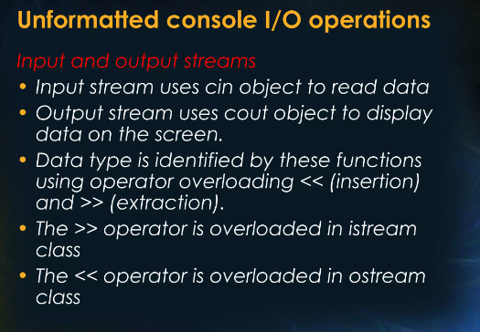

Slide 12
